Slide 1

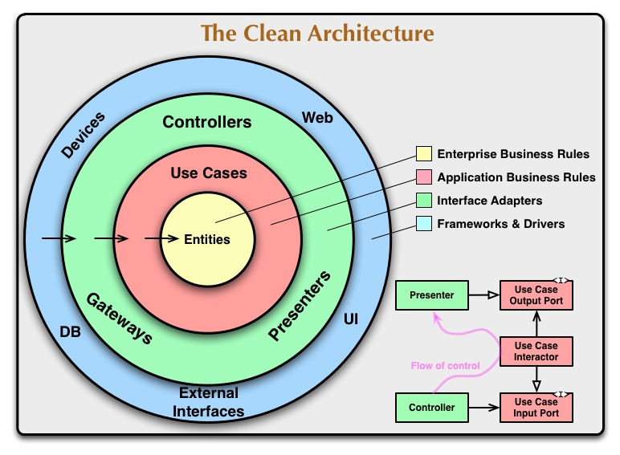
Lab 02 - The Clean Architecture
https://bit.ly/41OVauu

